Slide 1
CS 3282 Industrial Computer Engineering Project
L. A. R. L. Bandara
190077A

Slide 2
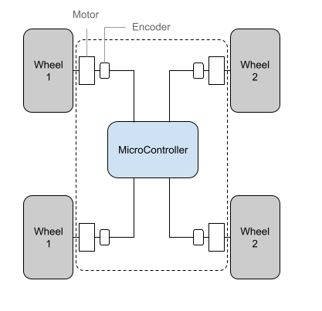
Introduction
Xavier is a robotic device for autonomous navigation in unstructured clattered environments.
It is capable of building detailed maps of the areas it explores.
The robot utilizes a skid steering technique for navigation.
Slipping of one wheel, resulting from either imperfect rigidity or surface conditions, poses a significant challenge.

Slide 3
Background
Robot employs skid steering, a technique that involves adjusting the speed of one set of wheels relative to the other to achieve turns.
However, an abnormal behavior has been observed in one of the wheels.
This behavior is attributed to either slipping or imperfections in the robot's rigid body, causing the wheel to deviate from its expected position.

Slide 4
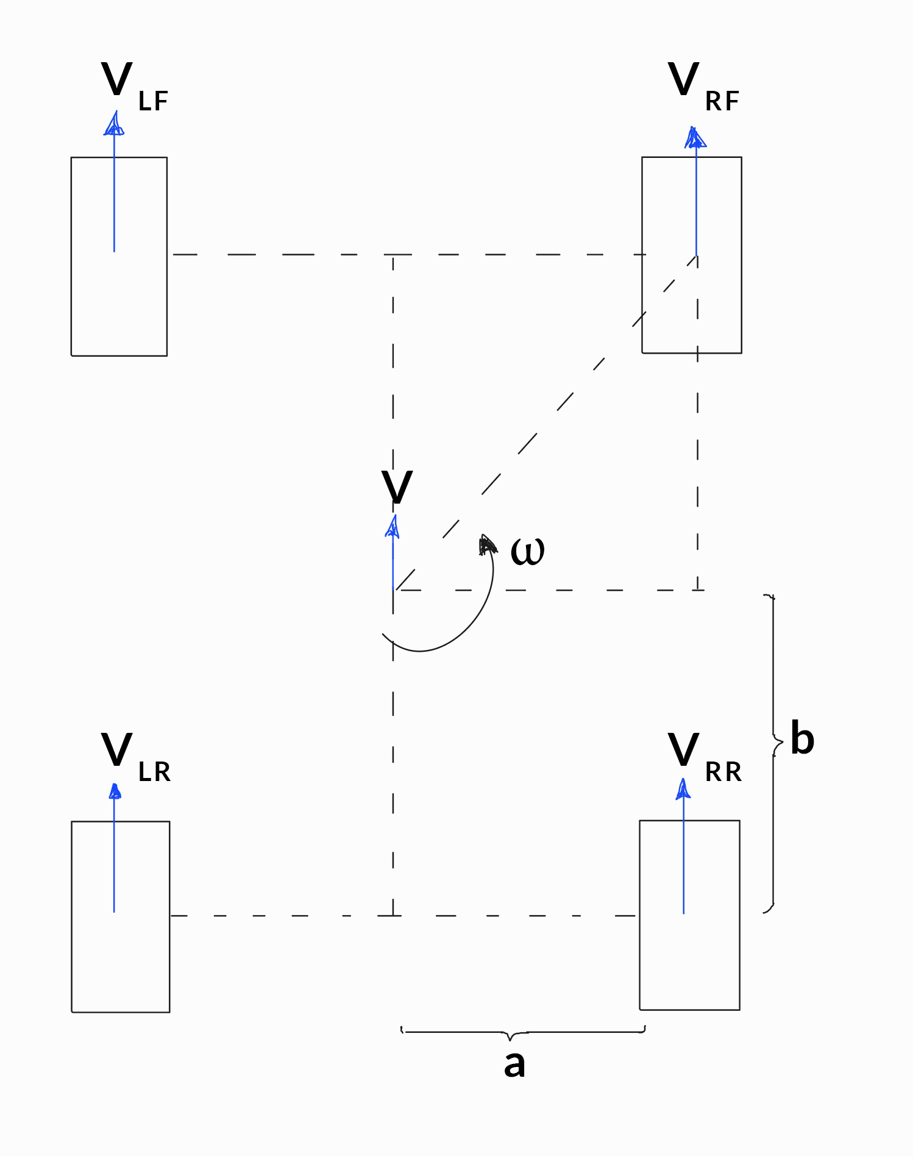


Problem Statement
The specific problem to be addressed is the detection and compensation of wheel slipping during turns.
The slipping effect can lead to inaccurate encoder readings, affecting the precision of the robot's movements.
The project aims to develop a robust algorithm that can identify slipping in real-time and implement corrective measures to ensure the robot maintains accurate positioning.

Slide 5
Objectives
Develop a program to process encoder readings and identify abnormal behavior in one wheel.
Implement a detection mechanism for identifying the natural deviations in the encoder values.
Devise a slipping compensation algorithm to adjust the erroneous wheel's readings and ensure accurate navigation.
Validate the algorithm's effectiveness through testing on the robot.

